Slide 1
IT SCHOOL
@ SiS
Łukasz Zmywaczyk​

Slide 2
AGENDA
Personal Introduction​
Course Introduction
​Hardware
Raspberry PI
​

Slide 3
INTRODUCTIONS

Slide 4
PERSONAL Introduction
Hello,
My name is Łukasz Zmywaczyk, and I have dedicated the past 20 years of my life to IT and Software Development. As we are currently witnessing the dawn of the AI revolution, I believe it is crucial for the younger generation to be well-prepared and adaptable to the upcoming changes in our world. To achieve this, I am passionate about sharing my knowledge and experience through my IT School course.
If you are interested in learning more about my experience, please feel free to connect with me on LinkedIn.

Slide 5
COURSE Introduction
Introduction to the course, Hardware
Robotics
Blockchain
Graphics
Text
AI, ML, Neural Networks
Security
Server Side
Client Side
API
Message Queues
Cloud (AWS)
MidJourney, ChatGPT
Algorithmics
Data Structures
Databases
HTML 5
Internet, DNS, LAN
Virtual Machines
Linux
itschool.sis@gmail.com +48-724-010-030
git@github.com:zmywak/it-school.git Łukasz Zmywaczyk

Slide 6
hardware

Slide 7
Anything that can go wrong with hardware will—at the worst possible moment.
“
”
hardware version of Murphy’s Law

Slide 8


WHAT IS WHAT
CPU
GPU
MOTHERBOARD
RASPBERRY PI 4
RAM
HDD
PSU
NIC

Slide 9

Raspberry pi

Slide 10
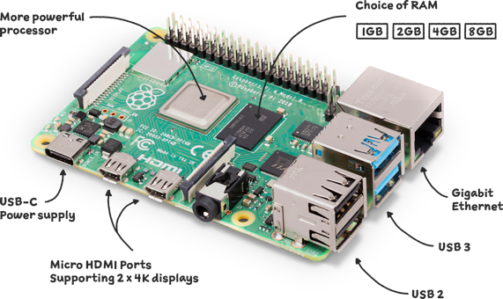
Powerfull mini computer
Quad-core ARM Cortex-A72 processor
GPU for graphics acceleration
RAM options (e.g., 1GB, 2GB, 4GB, 8GB)
USB ports, Ethernet, HDMI, and other connectivity options
MicroSD card slot for storage
GPIO (General Purpose Input/Output) pins for hardware interfacing

Slide 11





Example projects
SENSORS
SMART HOME
JASPER
RETRO GAMES
MEDIA
Weather Station
A smart home security system
Voice assistant
Retro gaming console
Media center for streaming videos and music

Slide 12
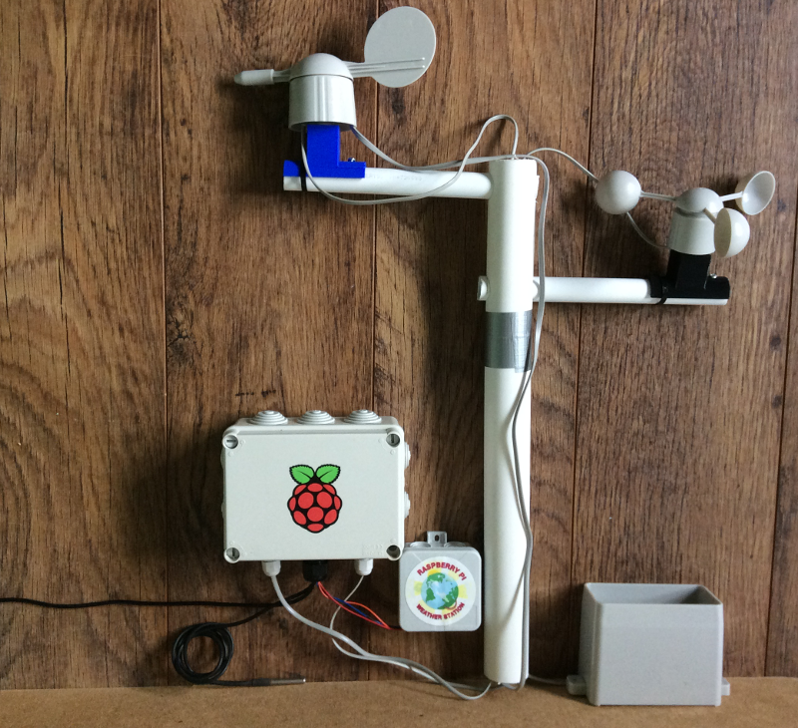
WEATHER STATION
Sensors:
  Temperature
  Humidity
  Pressure
  Rainfall
  Air quality ?
  Air speed
Data
Visualization
Triggers

Slide 13
THANK YOU
Łukasz Zmywaczyk

